Slide 1

Why optimization matters
SMALLER IMAGES MEANS:
FASTER DEPLOYMENTs
Lower storage costs
Quicker builds
Less vulnerabilities

Slide 2
Common Problems with Docker Images
Huge Image Sizes (due to unnecessary layers or dependencies)
Slow Builds & Caching Issues (improper layering)
Security Vulnerabilities (outdated base images, unnecessary packages)

Slide 3
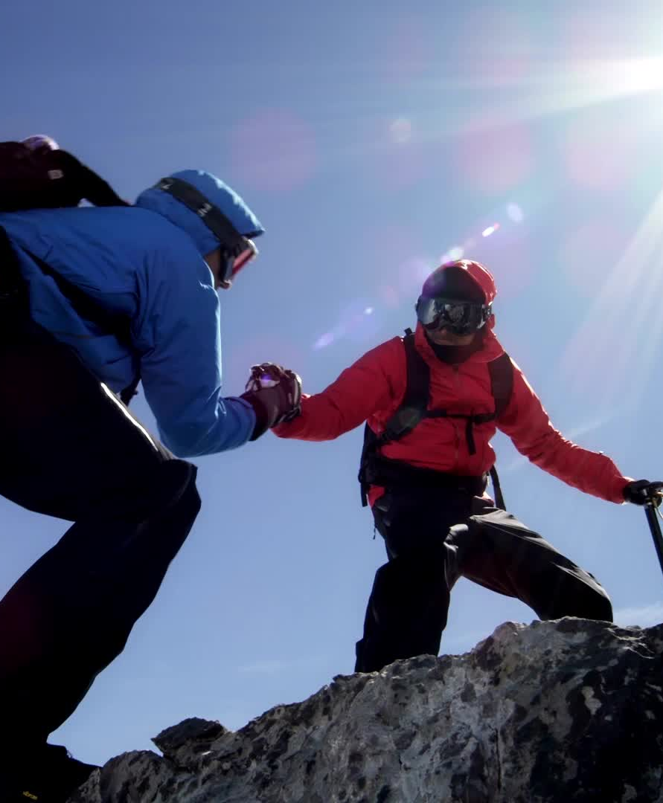
Best Practices to Optimize Docker Images
1. Use a Lightweight Base Image
Instead of ubuntu, use alpine
Example:
dockerfile
FROM alpine
Why? Alpine is 10x smaller than Ubuntu.

Slide 4
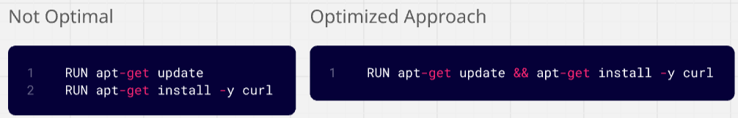
Best Practices to Optimize Docker Images
2. Reduce the Number of Layers
Combine commands using && to keep it clean

Slide 5
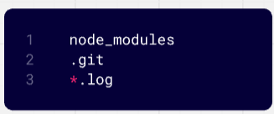
Best Practices to Optimize Docker Images
3. Use .dockerignore to Exclude Unnecessary Files
Example .dockerignore:
Why? Prevents bloated images with unnecessary files.

Slide 6
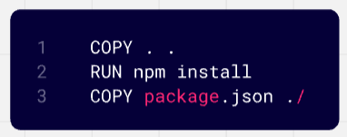
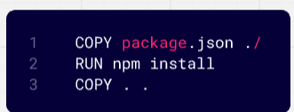
Best Practices to Optimize Docker Images
4. Optimize Layers & Caching
Place COPY and RUN commands in the right order to leverage caching.
Why? Changes in the source code won’t force unnecessary dependency reinstalls.

Slide 7
Best Practices to Optimize Docker Images
5. Use Multi-Stage Builds
Why? With multi-stage builds, Docker allows you to:
Use a separate stage to build the application.
Copy only the necessary files into a clean, final image.
Keep the final image small and efficient.

Slide 8
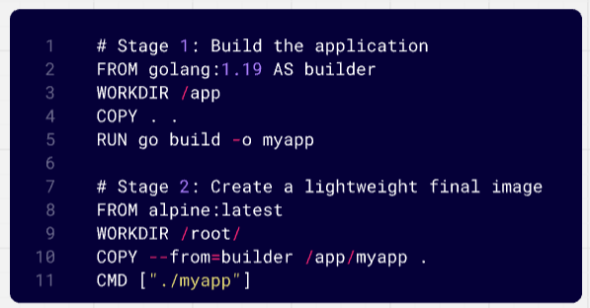
Docker Multi-Stage Build

Slide 9
Docker Multi Stage Demo (Without Stages)
mkdir go
cd go
vim main.go
package main
import "fmt"
func main() {
fmt.Println("hello, world")
}
vim dockerfile
FROM golang:1.23
WORKDIR /src
COPY main.go .
RUN go build -o /bin/hello ./main.go
CMD ["/bin/hello"]
docker build –t go:v1
docker image ls

Slide 10
Docker Multi Stage Demo (With Stages)
mkdir go
cd go
vim main.go
package main
import "fmt"
func main() {
fmt.Println("hello, world")
}
vim dockerfile
FROM golang:1.23 AS build
WORKDIR /src
COPY main.go .
RUN go build -o /bin/hello ./main.go
FROM scratch
COPY --from=build /bin/hello /bin/hello
CMD ["/bin/hello"]
docker build –t go:v2
docker image ls
docker run –d --name go-v1 go:v1
docker run -d --name go-v2 go:v2
docker logs go-v1
docker logs go-v2

Slide 11
Best Practices to Optimize Docker Images
6. Minimize unnecessary Dependencies
Use specific packages instead of installing a whole package manager.
Example: Install curl only when needed rather than apt-get update.
7. Always scan images for security vulnerabilities and keep them updated. This will secure your images.
Use tools like Tattler, Tenable, Trivy etc.

